Slide 1
CSE408 String Matching Algorithm
Lecture # 5&6

Slide 2
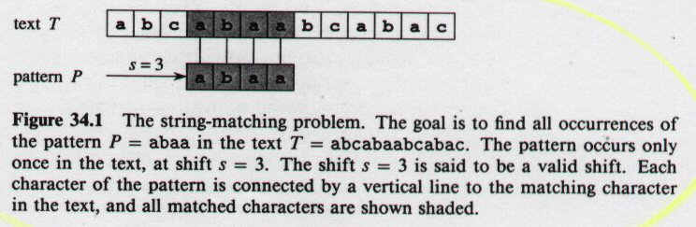
String Matching Problem
Motivations: text-editing, pattern matching in DNA sequences
32.1
Text: array T[1...n]
Pattern: array P[1...m]
Array Element: Character from finite alphabet Σ
Pattern P occurs with shift s in T if P[1...m] = T[s+1...s+m]

Slide 3
String Matching Algorithms
Naive Algorithm
Worst-case running time in O((n-m+1) m)
Rabin-Karp
Worst-case running time in O((n-m+1) m)
Better than this on average and in practice
Knuth-Morris-Pratt
best-case running time in O(n + m)

Slide 4
Notation & Terminology
Σ* = set of all finite-length strings formed using characters from alphabet Σ
Empty string: ε
|x| = length of string x
w is a prefix of x: w x
w is a suffix of x: w x
prefix, suffix are transitive
ab abcca
cca abcca

Slide 5
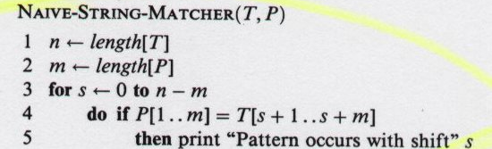
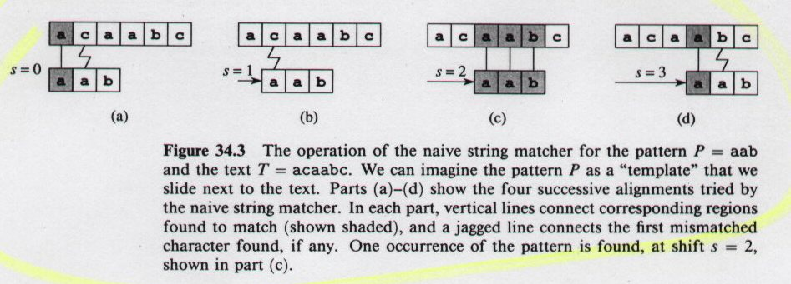
Naive String Matching
worst-case running time is in Θ((n-m+1)m)
32.4

Slide 6
Rabin-Karp Algorithm
Assume each character is digit in radix-d notation (e.g. d=10)
p = decimal value of pattern
t_{s} = decimal value of substring T[s+1..s+m] for s = 0,1...,n-m
Strategy:
compute p in O(m) time (which is in O(n))
compute all t_{i} values in total of O(n) time
find all valid shifts s in O(n) time by comparing p with each t_{s}
Compute p in O(m) time using Horner’s rule:
p = P[m] + d(P[m-1] + d(P[m-2] + ... + d(P[2] + dP[1])))
Compute t₀ similarly from T[1..m] in O(m) time
Compute remaining t_{i}‘s in O(n-m) time
t_{s+1} = d(t_{s} - d ^{m-1}T[s+1]) + T[s+m+1]

Slide 7
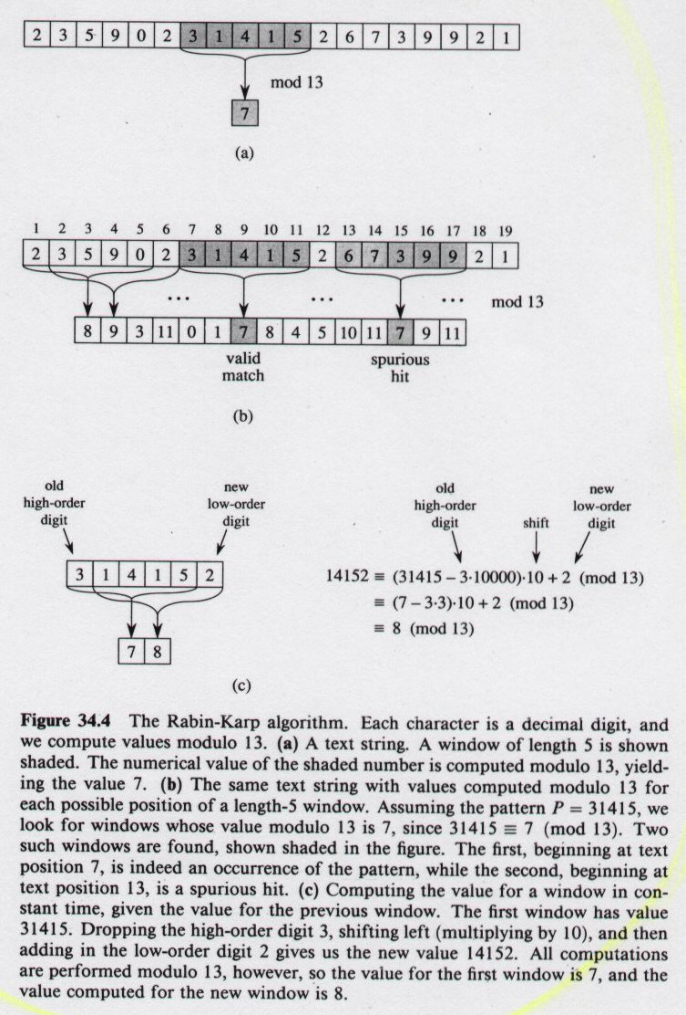
Rabin-Karp Algorithm
But...
p, t_{s} may be large, so use mod
32.5

Slide 8
Rabin-Karp Algorithm (continued)
But...
t_{s+1} = d(t_{s} - d ^{m-1}T[s+1]) + T[s+m+1]
p = 31415
spurious
hit

Slide 9
Rabin-Karp Algorithm (continued)

Slide 10
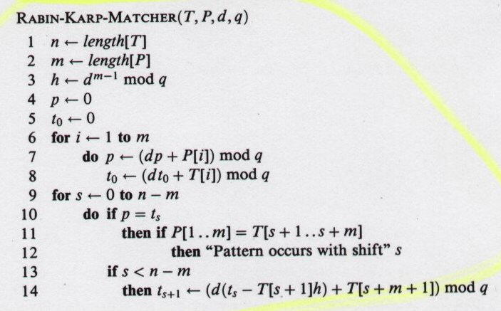
Rabin-Karp Algorithm (continued)
d is radix q is modulus
Θ(m) in Θ(n)
high-order digit position for m-digit window
Preprocessing
Θ(m)
Matching loop invariant: when line 10 executed
t_{s}=T[s+1..s+m] mod q
Θ((n-m+1)m)
rule out spurious hit
Θ(m)
Try all possible shifts
What input generates worst case?
worst-case running time is in Θ((n-m+1)m)

Slide 11
Rabin-Karp Algorithm (continued)
d is radix q is modulus
Θ(m) in Θ(n)
high-order digit position for m-digit window
Worst
Case
Preprocessing
Θ(m)
Matching loop invariant: when line 10 executed
t_{s}=T[s+1..s+m] mod q
Θ((n-m+1)m)
Θ(m)
rule out spurious hit
Try all possible shifts
Average Case
Assume reducing mod q is like random mapping from Σ* to Z_{q}
Estimate (chance that t_{s}= p mod q) = 1/q
# spurious hits is in O(n/q)
Expected matching time = O(n) + O(m(v + n/q))
(v = # valid shifts)
If v is in O(1) and q >= m
average-case running time is in Ο(n+m)

Slide 12
The Knuth-Morris-Pratt Algorithm
Knuth, Morris and Pratt proposed a linear time algorithm for the string matching problem.
A matching time of O(n) is achieved by avoiding comparisons with elements of ‘S’ that have previously been involved in comparison with some element of the pattern ‘p’ to be matched. i.e., backtracking on the string ‘S’ never occurs

Slide 13
Components of KMP algorithm
The prefix function, Π
The prefix function,Π for a pattern encapsulates knowledge about how the pattern matches against shifts of itself. This information can be used to avoid useless shifts of the pattern ‘p’. In other words, this enables avoiding backtracking on the string ‘S’.
The KMP Matcher
With string ‘S’, pattern ‘p’ and prefix function ‘Π’ as inputs, finds the occurrence of ‘p’ in ‘S’ and returns the number of shifts of ‘p’ after which occurrence is found.

Slide 14
The prefix function, Π
Following pseudocode computes the prefix fucnction, Π:
Compute-Prefix-Function (p)
1 m ← length[p] //’p’ pattern to be matched
2 Π[1] ← 0
3 k ← 0
for q ← 2 to m
do while k > 0 and p[k+1] != p[q]
6 do k ← Π[k]
If p[k+1] = p[q]
then k ← k +1
Π[q] ← k
10 return Π

Slide 15
Example: compute Π for the pattern ‘p’ below:
P
a | b | a | b | a | c | a
Initially: m = length[p] = 7
Π[1] = 0
k = 0
Step 1: q = 2, k=0
Π[2] = 0
Step 2: q = 3, k = 0,
Π[3] = 1
Step 3: q = 4, k = 1
Π[4] = 2
q | 1 | 2 | 3 | 4 | 5 | 6 | 7
p | a | b | a | b | a | c | a
Π | 0 | 0
q | 1 | 2 | 3 | 4 | 5 | 6 | 7
p | a | b | a | b | a | c | a
Π | 0 | 0 | 1
q | 1 | 2 | 3 | 4 | 5 | 6 | 7
p | a | b | a | b | a | c | A
Π | 0 | 0 | 1 | 2

Slide 16
Step 4: q = 5, k =2
Π[5] = 3
Step 5: q = 6, k = 3
Π[6] = 1
Step 6: q = 7, k = 1
Π[7] = 1
After iterating 6 times, the prefix function computation is complete: →
q | 1 | 2 | 3 | 4 | 5 | 6 | 7
p | a | b | a | b | a | c | a
Π | 0 | 0 | 1 | 2 | 3
q | 1 | 2 | 3 | 4 | 5 | 6 | 7
p | a | b | a | b | a | c | a
Π | 0 | 0 | 1 | 2 | 3 | 1
q | 1 | 2 | 3 | 4 | 5 | 6 | 7
p | a | b | a | b | a | c | a
Π | 0 | 0 | 1 | 2 | 3 | 1 | 1
q | 1 | 2 | 3 | 4 | 5 | 6 | 7
p | a | b | A | b | a | c | a
Π | 0 | 0 | 1 | 2 | 3 | 1 | 1

Slide 17
The KMP Matcher
The KMP Matcher, with pattern ‘p’, string ‘S’ and prefix function ‘Π’ as input, finds a match of p in S.
Following pseudocode computes the matching component of KMP algorithm:
KMP-Matcher(S,p)
1 n ← length[S]
2 m ← length[p]
3 Π ← Compute-Prefix-Function(p)
4 q ← 0 //number of characters matched
5 for i ← 1 to n //scan S from left to right
6 do while q > 0 and p[q+1] != S[i]
do q ← Π[q] //next character does not match
if p[q+1] = S[i]
then q ← q + 1 //next character matches
if q = m //is all of p matched?
then print “Pattern occurs with shift” i – m
q ← Π[ q] // look for the next match
Note: KMP finds every occurrence of a ‘p’ in ‘S’. That is why KMP does not terminate in step 12, rather it searches remainder of ‘S’ for any more occurrences of ‘p’.

Slide 18
Illustration: given a String ‘S’ and pattern ‘p’ as follows:
S
b | a | c | b | a | b | a | b | a | b | a | c | a | c | a
p
a | b | a | b | a | c | a
Let us execute the KMP algorithm to find whether ‘p’ occurs in ‘S’.
For ‘p’ the prefix function, Π was computed previously and is as follows:
q | 1 | 2 | 3 | 4 | 5 | 6 | 7
p | a | b | A | b | a | c | a
Π | 0 | 0 | 1 | 2 | 3 | 1 | 1

Slide 19
Initially: n = size of S = 15;
m = size of p = 7
Step 1: i = 1, q = 0
comparing p[1] with S[1]
S
b | a | c | b | a | b | a | b | a | b | a | c | a | a | b
p
a | b | a | b | a | c | a
P[1] does not match with S[1]. ‘p’ will be shifted one position to the right.
Step 2: i = 2, q = 0
comparing p[1] with S[2]
S
b | a | c | b | a | b | a | b | a | b | a | c | a | a | b
p
a | b | a | b | a | c | a
P[1] matches S[2]. Since there is a match, p is not shifted.

Slide 20
Step 3: i = 3, q = 1
Comparing p[2] with S[3]
p[2] does not match with S[3]
S
b | a | c | b | a | b | a | b | a | b | a | c | a | a | b
p
a | b | a | b | a | c | a
Backtracking on p, comparing p[1] and S[3]
Step 4: i = 4, q = 0
comparing p[1] with S[4]
p[1] does not match with S[4]
S
b | a | c | b | a | b | a | b | a | b | a | c | a | a | b
p
a | b | a | b | a | c | a
Step 5: i = 5, q = 0
comparing p[1] with S[5]
p[1] matches with S[5]
S
b | a | c | b | a | b | a | b | a | b | a | c | a | a | b
p
a | b | a | b | a | c | a

Slide 21
Step 6: i = 6, q = 1
Comparing p[2] with S[6]
p[2] matches with S[6]
S
b | a | c | b | a | b | a | b | a | b | a | c | a | a | b
p
a | b | a | b | a | c | a
Step 7: i = 7, q = 2
Comparing p[3] with S[7]
p[3] matches with S[7]
S
b | a | c | b | a | b | a | b | a | b | a | c | a | a | b
p
a | b | a | b | a | c | a
Step 8: i = 8, q = 3
Comparing p[4] with S[8]
p[4] matches with S[8]
S
b | a | c | b | a | b | a | b | a | b | a | c | a | a | b
p
a | b | a | b | a | c | a

Slide 22
Step 9: i = 9, q = 4
Comparing p[5] with S[9]
p[5] matches with S[9]
S
b | a | c | b | a | b | a | b | a | b | a | c | a | a | b
p
a | b | a | b | a | c | a
Step 10: i = 10, q = 5
Comparing p[6] with S[10]
p[6] doesn’t match with S[10]
S
b | a | c | b | a | b | a | b | a | b | a | c | a | a | b
p
a | b | a | b | a | c | a
Backtracking on p, comparing p[4] with S[10] because after mismatch q = Π[5] = 3
Step 11: i = 11, q = 4
Comparing p[5] with S[11]
p[5] matches with S[11]
b | a | c | b | a | b | a | b | a | b | a | c | a | a | b
S
p
a | b | a | b | a | c | a

Slide 23
Step 12: i = 12, q = 5
Comparing p[6] with S[12]
p[6] matches with S[12]
S
b | a | c | b | a | b | a | b | a | b | a | c | a | a | b
p
a | b | a | b | a | c | a
Step 13: i = 13, q = 6
Comparing p[7] with S[13]
p[7] matches with S[13]
S
b | a | c | b | a | b | a | b | a | b | a | c | a | a | b
p
a | b | a | b | a | c | a
Pattern ‘p’ has been found to completely occur in string ‘S’. The total number of shifts
that took place for the match to be found are: i – m = 13 – 7 = 6 shifts.

Slide 24
Running - time analysis
Compute-Prefix-Function (Π)
1 m ← length[p] //’p’ pattern to be matched
2 Π[1] ← 0
3 k ← 0
for q ← 2 to m
do while k > 0 and p[k+1] != p[q]
6 do k ← Π[k]
If p[k+1] = p[q]
then k ← k +1
Π[q] ← k
return Π
In the above pseudocode for computing the prefix function, the for loop from step 4 to step 10 runs ‘m’ times. Step 1 to step 3 take constant time. Hence the running time of compute prefix function is Θ(m).
KMP Matcher
1 n ← length[S]
2 m ← length[p]
3 Π ← Compute-Prefix-Function(p)
4 q ← 0
5 for i ← 1 to n
6 do while q > 0 and p[q+1] != S[i]
do q ← Π[q]
if p[q+1] = S[i]
then q ← q + 1
if q = m
then print “Pattern occurs with shift” i – m
q ← Π[ q]
The for loop beginning in step 5 runs ‘n’ times, i.e., as long as the length of the string ‘S’. Since step 1 to step 4 take constant time, the running time is dominated by this for loop. Thus running time of matching function is Θ(n).

Slide 25
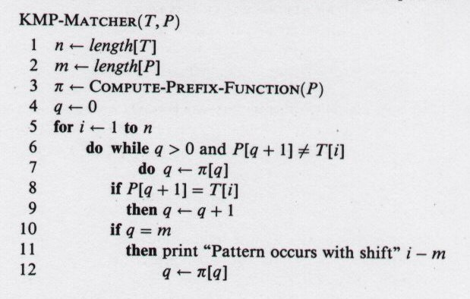
Knuth-Morris-Pratt Algorithm
Θ(m) in Θ(n)
using amortized analysis
# characters matched
scan text left-to-right
Θ(m+n)
next character does not match
Θ(n)
next character matches
using amortized analysis
Is all of P matched?
Look for next match

Slide 26
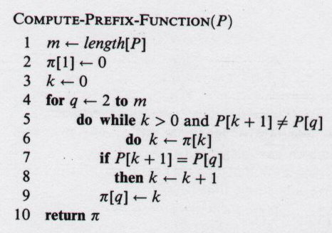
Knuth-Morris-Pratt Algorithm
Worst Case
Amortized Analysis
Potential Method
k = current state of algorithm
Potential is never negative since π (k) >= 0 for all k
Θ(m) in Θ(n)
initial potential value
potential decreases
amortized cost of loop body is in Ο(1)
Θ(m) loop iterations
potential increases by <=1 in each execution of for loop body

Slide 27
Thank You !!!

